Slide 1

Diversity Issues in Coaching
Cassandra Cho
Notes:
Hello, everyone!

Slide 2

Table of Contents
Understanding Diversity in the Coaching Profession
Coaching Style
Cross-Cultural Coaching
Organizational Culture
Addressing the Needs of this Population
Notes:
Today’s presentation explores the importance of understanding diversity in the coaching profession. My chosen coaching style and how it might take a role in this situation. Also, my current interest in the area of diversity: cross-cultural coaching. I will appreciate your attention and input regarding my ideas to address the needs of this population.

Slide 3

Understanding Diversity in the Coaching Profession
National Cultures
Sub-Cultures
Intercultural Perspectives
Cultural Frameworks
Special Training and Knowledge
Notes:
Cultural research does not limit itself to national cultures where the operationalization of research permits the distinction of sub-cultures (not small groupings) to favor their ethnicity or region (Milner et al., 2013). Several explanations of culture and cultural frameworks exit to map out various dimensions of development. Today, coaches are likely to work with coachees who come from different cultures to benefit the inclusion of an intercultural perspective. A cultural framework that relates to the context of coaching typically involves a cultural orientation that usually reflects, senses, or performs in a way that is socially determined. Therefore, special training and knowledge are necessary for coaches who must keep an expertise within a particular industry (Milner et al., 2013).

Slide 4

Cultural framework
Power Distance
Individualism vs. Collectivism
Masculine vs. Feminine
Uncertainty Avoidance
Long-term vs. Short-term Orientations
Notes:
Hofstede’s research with IBM employees across several countries provides a very good example of different dimensions within a cultural framework (Milner et al., 2013). Five dimensions of cultural significance were identified. Power distance refers to the less powerful members within an institution or organization that accepts, or expects an unequal power distribution. Individual vs. collectivism draws focus into the culture’s individualistic or group-orientation. Masculine vs. Feminine involves the difference between a culture’s emotional gender roles. Uncertainty avoidance reports on the feelings of being threatened by an ambiguous or unknown situation. Long-term vs. short-term orientations foster the virtues toward future rewards or virtue orientations that relate to the past or present.

Slide 5
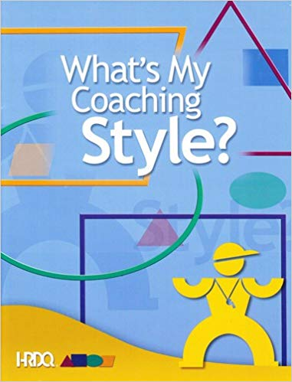
Coaching Style
Developmental Approach
Cultural Preferences
Constructive Developmental Theories
Frame of Reference
A Global Mobile Person Mindset
Notes:
A developmental approach certainly will help me to understand when to get out of the way for clients during a coaching event (Wilson, 2013). I do appreciate your time to allow my own understanding of myself and culture preferences before work time to engage someone else. Constructive developmental theories are on its way to empower the coaching profession which is key toward helping clients think more about their critical experiences. Particularly, when clients need time to pursue boundaries for themselves during a coaching appointment. As a coach trainee, I must first regard my ability to establish a frame of reference which will empower…open discussions and self-awareness for the growing developmental stages. I will be sure to hold on to the global mobile person mindset and mature beyond those identities in professional coaching to demonstrate a more integrative approach for clients and their organizations (Wilson, 2013).

Slide 6
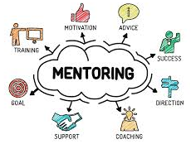
Societal Anchoring of Coaching
A World of Globality
Hypercomplex Society
A Society of Reflectivity
Fellowship
Notes:
Stelter (2009) conducts a brief analysis of societal change on the basis for justifying the general use of coaching and coaching psychology in a world growing social disorientation and restlessness. Open discussions on the loss of commonly accepted values and meanings question how experts and practitioners may best support the clients’ ability to navigate through diverse lifestyles and the multitudes of ‘local truths’. Everyone learn to be more open-minded and live together in a world of globality despite social, economic, and ethnic differences! This hypercomplex society will shape the social spheres to form organization, communication, and culture. There will be times where members utter the impossible to search for uniformity in the face of growing challenges and diversity because of the society of reflectivity. Fellowship must vary in understanding to work with others in maturing for self and changing cultures to identify the balance of various coaching styles (Stelter, 2009).

Slide 7

Broadening the Coachee’s Reflective Space
Universal Appreciation
Value Focus
Coaching Dialogue
Self-Consciousness
Coherence
Notes:
The coach should not try to understand the coachee as an ‘empirical’ person, but to appreciate what is ‘universal’ in their nature (Stelter, 2009). As a general human interest, the focus on values should not link the coachee to a subordinate position where he or she feels the need to follow “the boss.” The coaching relationship should offer a reflective space to develop a dialogue that grows to respect self-consciousness. This particular way of thinking provides a useful approach to strengthen coherence for the coachee’s independent, sense of self. Coaching is a process of personal and social meaning that aims to support people in the context of relating joint-actions to deliver a real community practice (Stelter, 2007). The coach creates a setting to effectively support the client’s transition into a new self-direction, which helps the client to understand their order of consciousness (Pinkavova, 2010).

Slide 8

Cross-cultural Coaching
Different National Backgrounds
Cross-Border Coaches
Organizational Culture
Effective Coaching Practices
Notes:
Cross-cultural coaching is a process in coaching where coaches and coachees originate from different national backgrounds (Milner et al., 2013). Several issues and challenges emerge when professional coaches work with coachees from diverse cultural settings, such as a cross-border coaching to systematically integrate a sub-culture into a professional coaching process (Rosinski, 2010). The organizational culture must not over emphasize a cross-cultural issue from which cultural differences recognize a real problem. This culture specific, intercultural coaching must reflect on how the concept of coaching and chosen tools are appropriate to support the coachees in their cultural surroundings. All coaches must be well-prepared to support the multitude of skills, knowledge, and intercultural mindsets for an effective coaching practice to grow across all cultures (Milner et al., 2013).

Slide 9

Organizational Culture
Diverse Cultural Experiences
Global Perspectives
Intercultural Communication
Markets with Ability and Propensity
Notes:
My interest in organizational culture is a result of diverse cultural experiences that involve a population’s lack of knowledge to adapt into a cross-cultural coaching (Wilson, 2013). As a result of my own experiences, I believe in the operations of research to reexamine the uncertainty of managing change for people who find it difficult to accept the concept of a global mindset. Intercultural communication is critical to impact the results of research to support others’ creative awareness and commitment to interpret a constructivist interpretative paradigm. It is crucial to question the rationale behind circumstances that are happening around us like understanding leverage from the researcher’s own background or boundaries set to effectively work in an organizational coaching. Be open to diverse cultural issues and markets with skills and propensities to develop this organization and culture to adapt your attitudes and behaviors into the new world (Wilson, 2013).

Slide 10

The global perspective
Global Environment:
  Cultural & Strategic Perspectives
Core Properties:
  Cognitive
  Existential
  Behavioral
Notes:
Studies on global mindedness tends to focus on the global environment by using the framework of two dimensions: cultural and strategic perspectives (Wilson, 2013). The cultural perspective refers to cultural diversity and managing across cultural boundaries. The strategic perspective refers to strategic complexities that stem from globalization. As a result, organizations face real challenges to prepare their coaches for a more integrative, systemic worldview approach. It is within this global mindset that three major components are found: intellectual, psychological, and social capital. Intellectual capital involves cognitive complexities, knowledge skills, and understanding. Psychological capital focuses on the cultural sensitivities and psychological fortitudes. Social capital includes trust, building trusting relationships, and collaborativeness. From the coaching profession viewpoint, global mindedness is critical to test the awareness and integration of managing and organizing the development of individuals who need to identify, learn, and speak that new global language (Wilson, 2013).

Slide 11

Addressing the Needs of this Population
The Critical Incidents Technique:
Communication
Coach-Client Relationships
Coaching Environment
Role Understanding
Notes:
Fifteen German coaching experts were interviewed to determine how a Western approach to coaching could be used within the context of a national culture (Milner et al., 2013). Semi-structured interviews based on the Critical Incidents Technique found critical incidents in four main areas: communication, coach-client relationship, coaching environment, and role understanding. The results show a focus to improve outcomes but not without the costs to identify the real core issues or reasons for coaching within a cross-cultural setting. Flanagan (1954) describes a critical incident as: “… any observable human activity that is sufficiently complete in itself to permit inferences and predictions to be made about the person performing the act. To be critical, an incident must occur in a situation, where the purpose or intent of the act seems fairly clear to the observer and where its consequences are sufficiently definite to leave little doubt concerning its effects.”

Slide 12

The Cosmopolitan Lifestyle
Notes:
The Cosmopolitan Lifestyle is about your willingness to engage the Other with an openness to support diverse cultural experiences (Wilson, 2013). Critical incidents in coaching demonstrate a unique cultural approach to management and building new talents and skills for oneself to prepare for the study abroad. According to Hannerz (1996), cosmopolitanism is about “the ability to both perceive the world as well as interact with other people’s countries and cultures in a way in which you put each other on an equal footing. You are open to each other’s differences and also very aware of your own perceptions and views of the world…you are trying to connect with the person, to meet them where they’re at and connect with them on that level.” Therefore, cosmopolitans are dependent on the locals to share their cultural diverse issues with the greater number of people which will enhance the process of globalization (Hannerz, 1996).

Slide 13

discussion
Notes:
Everyone take care to adjust your coaching methods and tools for an effective coaching process to provide critical feedback for all clients to rise beyond unforeseen influences, such as a “superior agenda.” Every coach must suit their coaching style to solidify work within the context of the cross-cultural coaching. Organizational culture will involve a mentoring or power distances that may cause the coach trainee to misinterpret the coaching role due to the mixture of directive and non-directive coaching styles, or virtue orientations to regard a more collectivist view (Bresser, 2013). Different ages and professional experiences may also limit the training and professional development of our coaches. Keep cultural influences separate from your interactions with the clients to support their autonomy and professional skills building. Help them identify and find their own solutions!

Slide 14
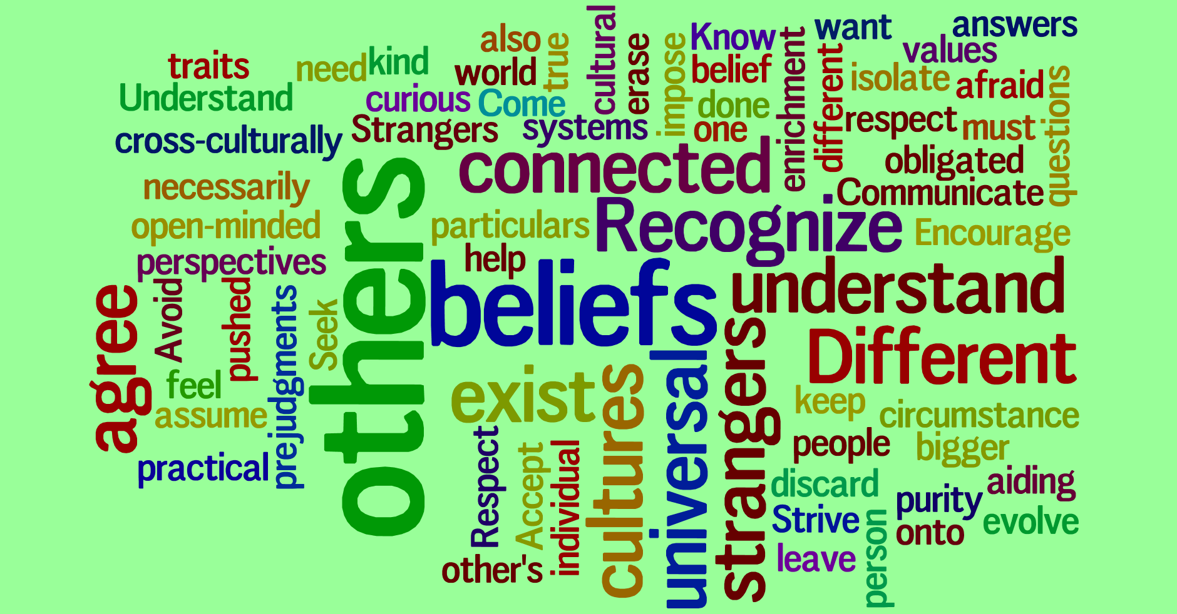
Conclusion
Notes:
Diverse cultural perspectives in coaching will continue to increase significance for people all over the world! My colleagues advance your practices to establish trust in the process of constructing data and report on the core contexts of cross-cultural themes (Wilson, 2013). This new global paradigm will challenge the coaching industry to manage inclusive thinking for all clients to incorporate critical experiences into their organizations. Global mindedness will require the team to establish a universal business culture to impact self-awareness for everyone to question difficulties involving the subject matter to embrace human resources. Professional coaching from a diverse cultural position will help individuals to step outside of their own interests to look into how other people may view the world!

Slide 15
References
Bresser, F. (2013). Coaching across the globe: benchmark results of the Bresser Consulting Global Coaching Survey with a supplementary update highlighting the latest coaching developments to 2013, Norderstedt, BoD.
Flanagan, J. C. (1954). The Critical Incident Technique. Psychological Bulletin, 51(4), 327–358.
Hannerz, U. (1996). Transnational connections: Culture, people, places. London: Routledge. Retrieved from http://ebookcentral.proquest.com Created from ncent-ebooks on 2019-03-09 11:55:01.
Milner, J., Ostmeier, E., and Franke, R. (2013). Critical incidents in cross-cultural coaching: the view from German coaches. International Journal of Evidence Based Coaching and Mentoring, 11(2), 19 – 32.
Pinkavova, E. (2010). Reflections from the field: keeping our heads above water: applying Kegan’s ‘order of consciousness’ theory in coaching. International Journal of Evidence Based Coaching and Mentoring, 8(1), 14 – 21.
Rosinski, P. (2010). Global coaching: an integrated approach for long-lasting results. London: Nicholas Brealey.
Stelter, Reinhard (2009). Coaching as a reflective space in a society of growing diversity – towards a narrative post-modern paradigm. International Coaching Psychology Review, 4(2), 209 – 219.
Stelter, Reinhard (2007). Coaching: a process of personal and social meaning making. International Coaching Psychology Review, 2(2), 191–201.
Wilson, W. (2013). Coaching with a global mindset. International Journal of Evidence Based Coaching and Mentoring, 11(2), 33 – 52.

