Slide 1

Total Quality Management
Cassandra Cho
School of Social and Behavioral Sciences, Northcentral University
PSY8404-9: Consulting in Business, Education, and Health
Dr. Lisa Cree
September 13, 2020
Cho
Notes:
Hello, Everyone! Today's PowerPoint Presentation examines the organization development method, Total Quality Management. First, I will describe the key elements of the TQM program. Then explain how organizations may choose to implement these issues. To conclude, by disclosing what comparative outcomes of the intervention may become in three different applied settings.

Slide 2
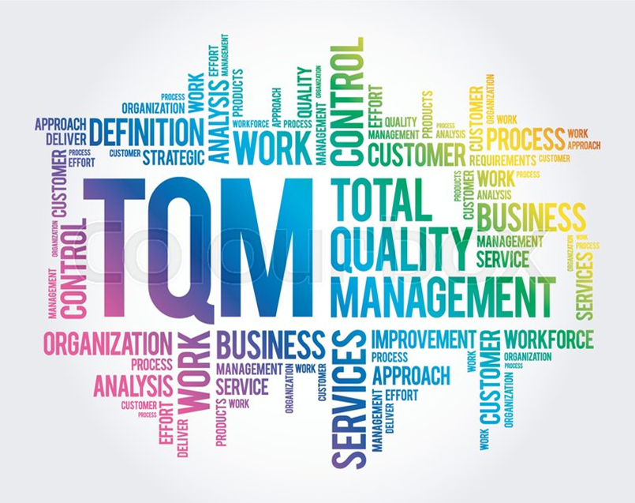
Total Quality Management (TQM)
Integrative Management Philosophy
Continuous Improvement
Contextual Variable Choices
Customer-Oriented Relationships
*https://www.colourbox.com/vector/tqm-total-quality-management-vector-35136810
Cho
Notes:
In 2016, van Schoten and his fellows defined "TQM as an integrative management philosophy that aims for continuous improvement in the quality of products and services within an organization." The successful implementation of the TQM method will depend on how the association may process contextual variables, such as the application of TQM viewpoints into customer-related sectors. TQM in healthcare, for example, could help teams discover their reasons for unnecessary activities to protect patient care procedures with goals set to deliver a more conducive recovery effort. The reduction of effect variation minimizes participant labor costs to aim for better healthcare opportunities.

Slide 3
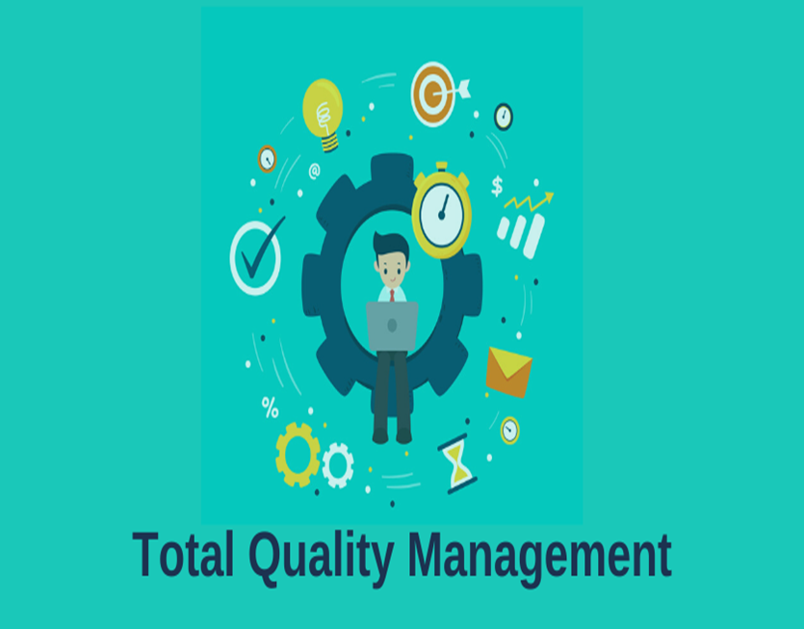
Total Quality Management in Three Applied Settings
A Roadmap for Implementing TQM Practices in Medium Enterprises
Developing a Performance Management Model for the Implementation of TQM practices in Public Education Centres
Opportunities for TQM training in Associations of Organic Producers in Republic of Macedonia
*https://www.skillrary.com/blogs/read/total-quality-management
Cho
Notes:
To start, the roadmap for implementing TQM practices in medium enterprises examines a systematic approach toward learning for members to acquire knowledge that is necessary to lead innovations toward global market change (Yadav, 2015). The continuous improvement of shareholders will suggest work as an opportunity to advance ideas relating to a healthy outlook on standardizing strategies. Second, developing a performance management model for the implementation of TQM practices in public education centres to address a higher quality education using the Balanced Score Card to research the development of a comprehensive management tool for non-university public education (Mateos-Ronco & Mezquida, 2018). Three, employment opportunities for TQM training in associations of organic producers in the Republic of Macedonia advance with the surveying of members on issues involving economic development, environmental safety & health, and growing food with customers in mind (Naumova-Mihajlovska, 2016). TQM in agriculture business will support consumer needs before restructuring the quality of food production services.

Slide 4

A Roadmap for Implementing TQM Practices in Medium Enterprises
Top Management Commitment
Development of Mission, Vision, & Quality Plan
Development of Implementation Plan
Ask for Total Involvement by All
*https://blog.capterra.com/what-is-total-quality-management/
Cho
Notes:
According to Yadav (2015), the medium enterprises (MEs) who show interest in forming a quality improvement instrument may adopt the TQM model to structure guidelines for its personnel. The commitment of top management is essential to develop rewards for employee excellence who share in the responsibility of achieving a quality product. Creating a mission, vision, and quality plan as an organization represents a direct purpose in maintaining priorities set to challenge the company's interests to support the long-term quality of employees, consumers, and suppliers. The improvement plan development will take a few years before shareholders receive benefits from their labor. Total involvement from all members of a TQM organization means employees and their teams own the driving force to deliver appropriate training with quality-related techniques to improve their motivation and management of healthy work environment.
According to Yadav (2015), the medium enterprises (MEs) who show interest in forming a quality improvement instrument may adopt the TQM model to structure guidelines for its personnel. The commitment of top management is essential to develop rewards for employee excellence who share in the responsibility of achieving a quality product. Creating a mission, vision, and quality plan as an organization represents a direct purpose in maintaining priorities set to challenge the company's interests to support the long-term quality of employees, consumers, and suppliers. The improvement plan development will take a few years before shareholders receive benefits from their labor. Total involvement from all members of a TQM organization means employees and their teams own the driving force to deliver appropriate training with quality-related techniques to improve their motivation and management of a healthy work environment.

Slide 5
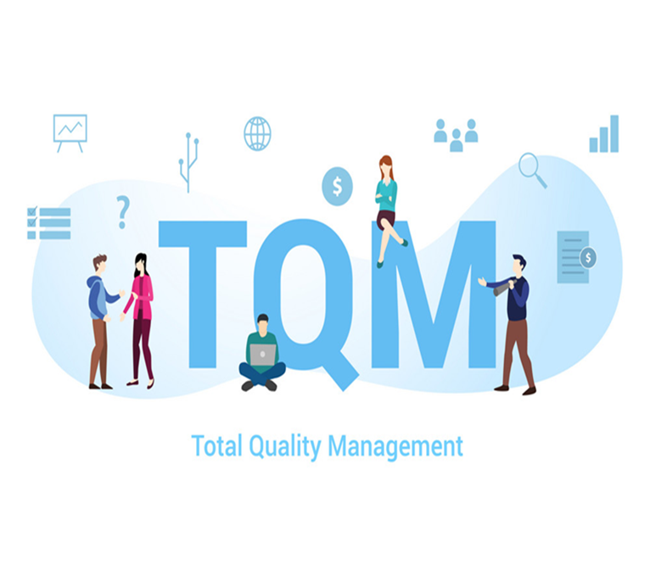
A Roadmap for Implementing TQM Practices in Medium Enterprises (continued)
Establishment of Education & Training Programs
Start Implementation Phase
Maintaining the Implementation Effort with Continuous Improvement
*https://www.vectorstock.com/royalty-free-vector/tqm-total-quality-management-concept-with-big-vector-28061173
Cho
Notes:
Corporate training and development offer participants the opportunity to make things real by managing the workforce knowledge to produce skills that are necessary to improve its operations. A well-trained labor force is crucial for personnel to increase their work productivity focus. The implementation phase should transform employee decision-making to sustain TQM management efforts accepting interpersonal skills, performance evaluations, and problem-solvers. In MEs, the ability to maintain the implementation effort with a continuous improvement means the organization must commit to the regular examination of administrative and technical support. The entire system impacts the development of specific tools to maintain road map behaviors for all personnel. For instance, the Statistical Process Control tool can improve the quality of best practices for employees regularly to protect their organization from competitors (Yadav, 2015). TQM training and development delivers a reliable learning process for participants to receive the necessary data and feedback to accomplish continuous improvement success.

Slide 6
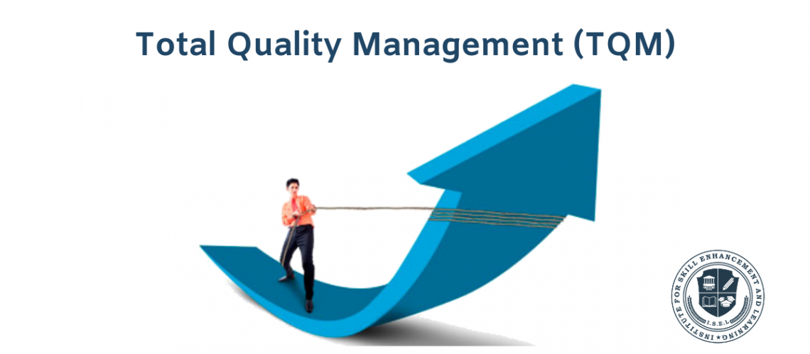
Developing a Performance Management Model for the Implementation of TQM practices in Public Education Centres
European Foundation for Quality Management
Real Cause-and-Effect Relationships
Delphi Method
Balanced Score Card
*https://iselglobal.com/2019/04/total-quality-management-tqm-importance/
Cho
Notes:
The European Foundation for Quality Management brings TQM practices into the management design of education centres to structure an excellence model that will improve the quality needs of individuals (Mateos-Ronco et al., 2018). Organizations identify the development of real cause-and-effect relationships requiring various steps to implement strategies, evaluations, and quality improvements. Experts obtain a set of indicators to analyze the effects of measuring performance and monitoring strategies to develop a comprehensive management tool using the Delphi method. The Balanced Score Card did show a high probability of becoming a valuable instrument in determining the reliability and validity of management competencies. TQM in public education centres can make it easier for individuals to understand how educational performance and achievement of excellence result in a more significant organizational presence.

Slide 7
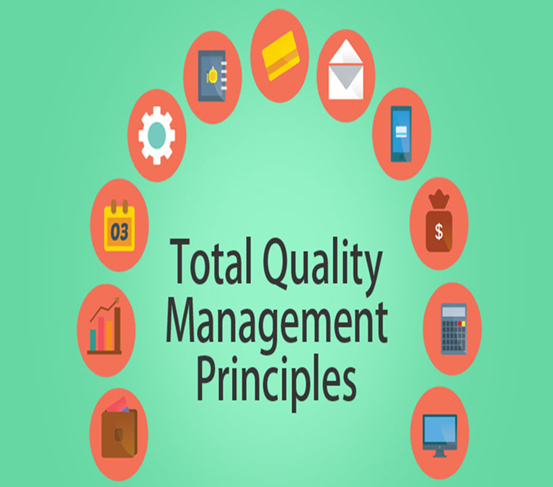
Developing a Performance Management Model for the Implementation of TQM practices in Public Education Centres (continued)
Welfare Assets
Four Strategic BSC Perspectives
  Financial
  Customer
  Internal Process
  Learning and Growth
Vocational Skills
*https://www.educba.com/total-quality-management-principles/
Cho
Notes:
Introducing the BSC tool into a public education centre calls for statistics, subtasks, and guidelines to promote participant ideals and perspectives (Mateos-Ronco et al., 2018). As a result, society needs the public sector to encourage welfare assets in terms of increasing the aims and standards of services. Four strategic perspectives make up the general BSC model: Financial, Customer, Internal Process, and Learning & Growth. Members will be able to implement the TQM practices within their organizations as their performance management schemes reduce learning difficulties to gain compliance and strengths from other participants. From a humanistic view, individuals will have the opportunity to network their vocational skills with professionalism to advance TQM training out in the field.

Slide 8
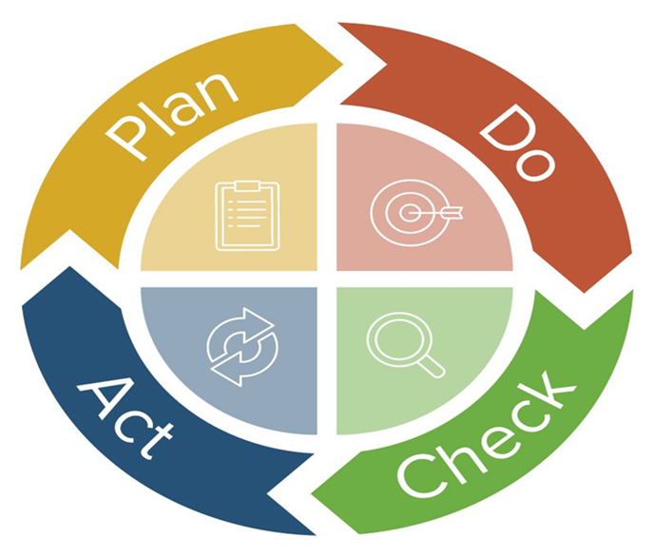
Opportunities for TQM training in Associations of Organic Producers in the Republic of Macedonia
Characteristics of Training Under the Principles of TQM:
Education
Testing
Additional Education and Research
Approving the System for Quality
*https://www.smartsheet.com/total-quality-management
Cho
Notes:
Plan-Do-Check-Act aids in the operation of knowledge for businesses and organizations to function as a whole system (Naumova-Mihajlovska, 2016). Education should be a high priority focus for stakeholders to support their method of training with new information and skills to help the broad range of organic producer associations to adapt to global change and continuous learning. Testing determines if the TQM model suits how the system may benchmark its procedures to achieve control of applied methods and strategies to complete tasks. Additional Education and Research ensures the TQM procedures effectively demonstrates the education requirements within the system. Approving the System for Quality is a critical process for agricultural businesses because its primary responsibility is to produce a quality of food products and services that individuals will promote to challenge their national economy. Every department within the organization should commit to the TQM process with a long-term focus on improving the quality and standards of living for everyone.

Slide 9
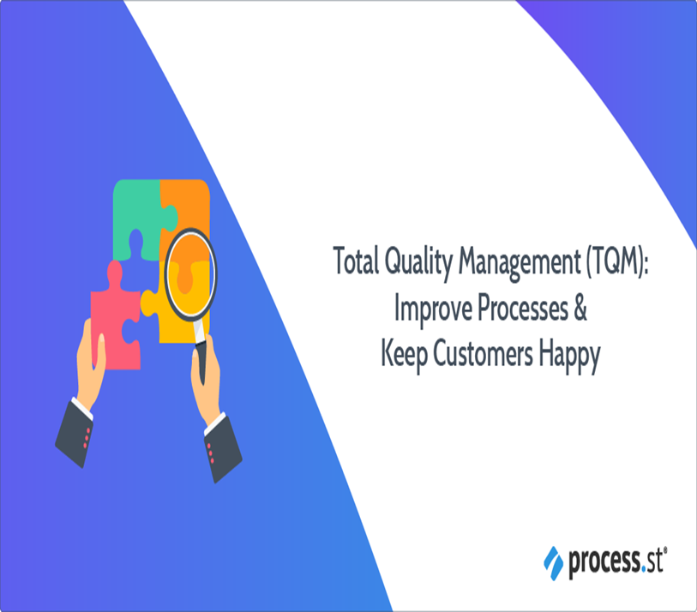
Opportunities for TQM training in Associations of Organic Producers in the Republic of Macedonia (continued)
Staff Motivation
Minimizing Resistance
New Communication Protocol
Economic Durability
**https://www.process.st/total-quality-management-tqm/
Cho
Notes:
Motivating members will not be an easy task, immensely when circumstances to improve the quality of work are not clear to support communication between various positions. TQM training can minimize psychological factors and material that may cause resistance for employees who must work together under extreme conditions (Naumova-Mihajlovska, 2016). The association of producers of organic products could increase their operational and production assistance by using organizational consultation to help the members market a new communication protocol. One of the main issues producers face is applying the placement of logic with attitudes to communicate the permanence of cooperative efforts. Quality in agribusiness provides an innovative tool for consumers to express their economic views on the accuracy and reliability of marketable products.

Slide 10

Key Factors of the TQM Intervention
Social-Soft & Technical-Hard Dimensions
Simultaneous Management
Organizational Performance
Quality Management
Quality Improvement
*https://draminu.com/total-quality-management-principles/
Cho
Notes:
According to van Schoten and his colleagues (2016), three core principles underlie the TQM approach in the literature. The primary concepts split up into two groups: the social-soft and technical-hard dimensions. The social-soft aspect captures the human resource management perspectives of the organization. The technical-hard part considers the continuous improvement of goods and services by studying production procedures. Next, the two dimensions and their fundamental capabilities will need to focus on simultaneous management because both are interconnected. The power of each component will lead to the expansion and growth of their organizational performance. It will take a considerable amount of time to establish that wholesome outlook on Quality Management with routines to resource Quality Improvement, which are two critical elements for TQM to verify feedback on organizational performance.

Slide 11

How Organizations May Choose to Implement These Issues
Malcolm Bridge Quality Award
European Foundation for Quality Management Excellence Model
New Public Management
*https://www.istockphoto.com/vector/tqm-total-quality-management-concept-with-keywords-letters-and-icons-flat-vector-gm1126674641-296709374
Cho
Notes:
Numerous approaches have led organizations to develop their TQM principles, such as the Malcolm Bridge Quality Award and the European Foundation for Quality Management Excellence Model (van Schoten, de Blok, Spreeuwenberg, & Groenewegen et al., 2016). Quality Management has become the subject of numerous debates that have been contemplating how its success within the business field may contribute to achievements within the education domain. For instance, the EFQM model may serve as a framework within the hospital healthcare setting. Over time, clinical outcomes and patient satisfaction note how the TQM process led to saving lives, thus improving their quality of life. The New Public Management model can also enhance the quality management for education centre participants by utilizing the results of TQM concepts from the business industry to increase the effectiveness of public vocational training supervision with lower costs (Mateos-Ronco et al., 2018).

Slide 12
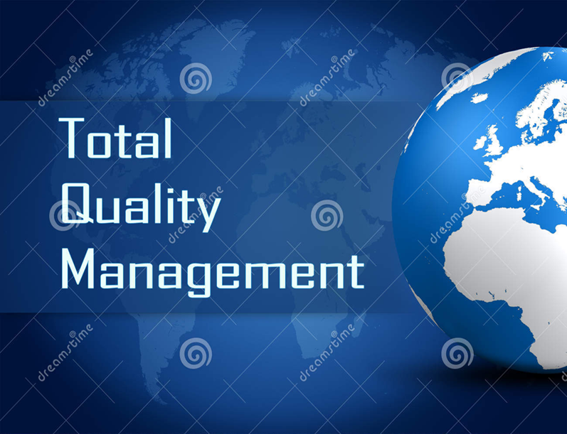
Comparative Outcomes of the TQM Program in Different Settings
Educating the Presidency before Training the Organization
Top Management Commitment to Improve Organizational Structure
Resources to Develop a Flexible Intervention Plan
*https://www.dreamstime.com/royalty-free-stock-photos-total-quality-management-concept-globe-blue-world-map-background-image39549028
Cho
Notes:
According to Naumova-Mihajlovska (2016), the general improvement of work in associations of producers of organic products will surely benefit the execution of TQM practices with higher-level abilities to grow in the market for themselves. The authors recommend educating the presidency before training the organizations to support continuous improvements and global changes in their operations. This approach is similar to the medium enterprise study where top management commitment to align TQM practices with firm policies uses employee suggestions and responsibilities to improve its organizational structure, which increases the quality of product excellence to capture the global market. MEs find the TQM model useful as an assessment tool to determine if training resources are open for members to develop a flexible intervention plan.

Slide 13

Comparative Outcomes of the TQM Program in Different Settings (continued)
Continuous Improvement
Business Restructuring
Collaboration
Creative Leadership
Conducive Work Environment
*https://padeepz.net/ge6757-total-quality-management-important-questions-regulation-2013-anna-university
Cho
Notes:
TQM in agribusiness highlights continuous improvement for producers to develop best practices involving employee cooperation, satisfaction, and teamwork. Continuous improvement in medium-scale enterprises also requires an orientation of excellence for personnel to gain in positive performance efforts. Not only does TQM restructure business conditions for agricultural producers to collaborate with consumers and other workers. It creates quality in terms of creative teamwork to boost overall member satisfaction. Cooperation in MEs also involves a quality practice to motivate organizational efficiency for employees to seek excellence in all things resourceful. TQM highlights creative leadership to incorporate motivation and win-win activities into a conducive work environment.

Slide 14

*https://www.6sigma.us/six-sigma-articles/understanding-most-important-elements-of-tqm/
Cho
Notes:
The ability of people to maintain a competitive advantage out in the work environment will depend on their respect for quality (Nguyen & Chau, 2017). TQM could boost innovation and performance for a firm to manage the role of mediation in the development of empirical research. The impact of TQM usefulness to change behaviors for an organization may determine its business success. Product quality can preserve customer loyalty over the competition by sharing welfare assets to discuss survival in the global marketplace. Organizational development and leadership to support consumer demands could promote technological advances to satisfy the TQM program with the existing system as being a continuous improvement process. People, take care of professional opportunities to grow and mature over time to excel as a TQM leader!

Slide 15
References
Mateos-Ronco, A. & Mezquida, J.M.H. (2018). Developing a performance management model for the implementation of TQM practices in public education centres. Total Quality Management, 29(5), 546 – 579. https://doi.org/10.1080/14783363.20161216309
Naumova-Mihajlovska, K.H. (2016). Opportunities for TQM training in associations of organic producers in Republic of Macedonia. Economic Development, 3, 192 – 207.
Nguyen, V.C. & Chau, N.T. (2017). Research framework for the impact of total quality management on competitive advantage: the mediating role of innovation performance. Review of International Business & Strategy, 27(3), 335 – 351. doi: 10.1108/RIBS-02-2017-0016
van Schoten, S., de Blok, C., Spreeuwenberg, P., Groenewegen, P., & Wagner, C. (2016). The EFQM Model as a framework for total quality management in healthcare: results of a longitudinal quantitative study. International Journal of Operations & Production Management, 36(8), 901 - 922. doi: 10.1108/IJOPM-03-2015-0139
Yadav, R. (2015). A roadmap for implementing total quality management practices in medium enterprises. The IUP Journal of Operations Management, XIV(4), 7 - 23.
Cho

Slide 16
Cho

