Slide 1

Systematic Training Design: Time management Skills Training
Cassandra Cho
Notes:
Hello, everyone! Today, I represent a systematic training design to improve your time management skills (Noe, 2017). As associates within this organization, a needs assessment was necessary to determine if employees understood the incentives to support learning and transfer of training when experiences and skills could offer a better work situation for other people. The results question the learners’ ability to identify who might need further assistance or training to minimize knowledge gaps due to variance in age or generation. The leaders of the company agreed to release funds for time management skills training with thoughts to improve behavioral change and performance for administration, customer services, and job redesign. This program provides a way for learners to coordinate content and feedback with opportunities to practice and interact with external workplace resources.

Slide 2

Table of Contents
Needs Assessment
Program Design
Learning and Transfer of Training
Training Evaluation

Slide 3

Organizational Analysis
Support for Training Activities:
Managers
Peers
Employees
Notes:
The organizational analysis will identify how training could support the company’s strategic goals to develop more human resources (Noe, 2017). Everyone is open to budget their time and expertise to establish the training and development courses. Current research suggests a positive attitude toward training activities as being a critical asset for trainees to perform effectively on the job. Employees were likely to apply the contents of training using their cognitive abilities and skills to increase communication and positive feedback. As a result, this training design will aid in the development of personal characteristics to steadfast solutions regarding the complexities of performance issues. That is, verbal comprehension, quantitative and reasoning capabilities. Everyone, your motivation to learn is critical to establish a viable skill building unit to overcome weaknesses involving constraints out in the real world! The learning and training design should encourage all trainees to develop time management skills wisely.

Slide 4

Person and Task Analyses
Minimize Error & Learning Difficulties
Develop Competencies
Multitask Relationships
Internal & External Decision-Making
Notes:
The results of the person and task analyses describes concern for labor efforts regarding tasks performed by individuals, managers, and their work groups to minimize error and learning difficulties (Noe, 2017). Everyone must consider their use of knowledge, skills, and abilities (KSAs) to complete their everyday tasks and responsibilities while developing competencies with other people to learn and transfer new time management skills training. The company does appreciate your commitment to multitask information and relationships within the workplace to include the explanation of conditions concerning the internal and external decision-making. Learners do take the time to develop an appropriate performance standard to support your ability to practice with others on-the-job!

Slide 5

Competency Model
Organizational Capabilities
Real Job Designs
Connecting Business Strategies & Goals
Top Performer Interviews & Focus Groups
Human Resources
Notes:
A competency model will help the organization to understand what capabilities are necessary for employees to perform from one business unit to another (Noe, 2017). The best employees are given open positions to gain and develop specific knowledge, skills, and abilities for real job designs. The explanation of interpersonal, leadership, sales, technical, and other competencies are central toward connecting business strategies and goals to behaviors with a larger purpose such as employee development, performance management, selection, and training. Top performer interviews and focus groups will provide direct feedback and examples to validate and review deficiencies in overall work performance. The competency model is a way for trainees to succeed in meeting today’s needs as well as future actions to develop human resources with different career practices. Think about it as various occupational groups or levels of jobs within a performance system that will meet the needs of an effective time management skills training.

Slide 6
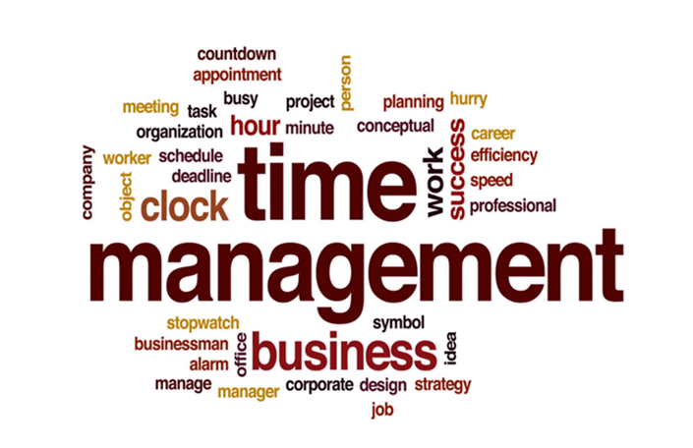
The Program Design
Pre-Training Activities
Training Event
Post-Training Activities
Training Evaluation
Notes:
The needs assessment information identifies specific activities to best suit your pre-training, learning event, and type of assistance that deems you appropriate to coordinate the transfer of training after the training ends (Noe, 2017). Phase 1 involves preparing the trainees to willingly motivate themselves to support the overall learning process. This pre-training course will help you develop a physical environment (i.e., the climate, managers, peers) to support learning and transfer of training. Phase 2 involves the instructions to empower learning out in the physical environment. Create a positive learning to support training and selection of high-quality instructors or trainers to design and plan activities for time management skills training. Phase 3 involves learning how to apply what you have learned in training to your work. Majority of your time, labor, and financial resources should focus on designing this part of learning to transfer your knowledge to the overall company’s training portfolio.

Slide 7

Positive Transfer of Best Practices in Training Design
Employee Engagement
Training Expansion
Continuous Improvement
Learner Transformation
Notes:
A literature review on “best practices in training design for positive transfer” found an increase in employee engagement due to start of training classes with improvements to its operations and manufacturing times (Sisson, 2019). Positive results are evident when front-line supervisors expand their training successfully to other work sites within the company. The evaluation and continued improvement of the training program are indispensable when it comes to future training, action research, philosophies, and training best practices. Reasons for training failure suggests a lack of supervisory knowledge to transform management practices for teams to continue their day-to-day improvements. The development of an effective training program depends highly on the ability of learners to mature from lessons that make it hard for them to change their behaviors or design strategies to engage problem-solving with other employees. Be sure skills are taught to transfer training material properly throughout the work environment.

Slide 8
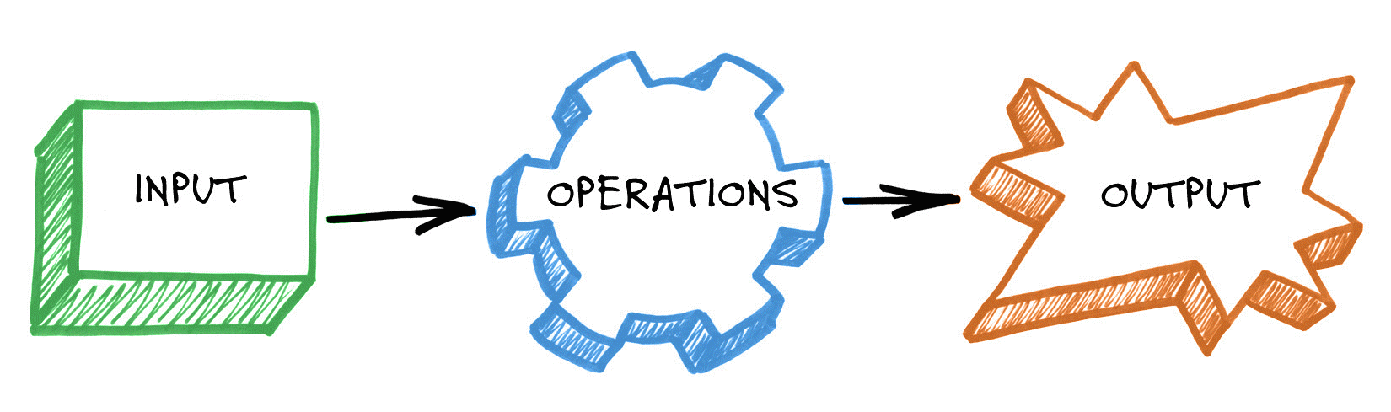
the learning process and its implications on how people learn
Response Capabilities
Capacity Building
Training Products
Collaborative Efforts
Notes:
The program design intends to establish an evidence-based practice to identify the challenges that are key to strengthen all learner response capabilities (Qari, Leinhos, Thomas, & Carbone, 2018). A major component is the capacity building of employees to coordinate events involving in-person training, online webinars, and on-the-job exercises. The training products are necessary to improve communication, evaluation, planning, and other activities to manage new perspectives in mentorship and preparation for time management skills. A user-friendly approach meets the requirements of the research to turn new knowledge into a collaborative effort to practice and deliver tools necessary to benefit the voice of experiences.

Slide 9
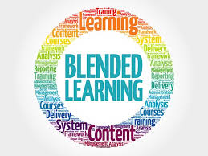
Online Training Protocol
Training Program Implementers
Target Audience Practices
Systematic Evidence-Informed Framework
Larger Training Scale
Notes:
The development of online methods to facilitate a more feasible intervention by training program implementers to deliver content consistently with instructional best practices will improve organizational procedures to experience the target audience in practice more than traditional seminar-type meetings (Gavarkovsa, Bluntb, & Petrellab, 2019). In-person training and workshops require human and financial resources to impact the fidelity of training people within a systematic evidence-informed framework. Online platforms provide a way for researchers to develop a larger training scale using a broader cycle of informed skills to modify the intervention as needed. Individuals within the organization could easily support the training of new hires or learning principles to utilize data at different professional work levels. Further examination of the training protocol will assist the physical capabilities of the trainees to determine what factors may affect the program design to support the use and modification of subsequent steps to improve the overall effectiveness of the online training program.

Slide 10
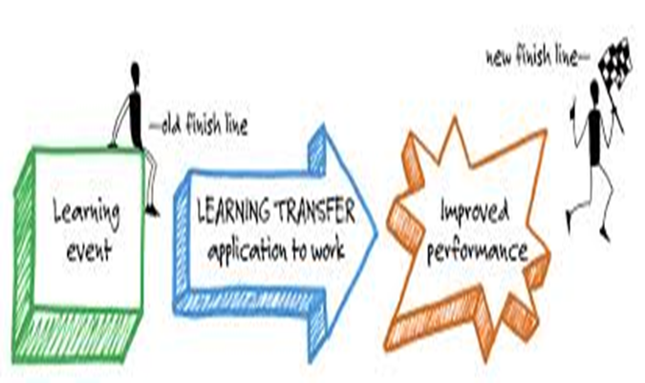
Learning and Transfer of Training
Environmental Influences
Cognitive Strategies
Observation
Generalization & Maintenance
Manager & Peer Support
Notes:
There may be times when environmental influences make it hard for you to generalize and maintain what you have learned to transfer materials appropriately on the job (Noe, 2017). Your cognitive strategies are crucial to relate decisions that you have made to process information in learning and training transfer to question and resolve problematic issues. People learn well by observation and will repeat their behaviors if they believe someone is credible or perhaps some direct reward is involved. Do well to remember and recall what you have learned from this systematic training design. Learners who experience manager and peer support readily tend to transfer training objectives faster to encourage learning principles out in the real world. The main tasks are to emphasize the trainees’ ability to use the time management skills training within a new group of employee behaviors so they may learn to work in various situations within a dynamic mindset to transfer their training knowledge.

Slide 11

Post-Training Activities
Practice Opportunities
Peer Support
Team Meetings
Training Evaluation
Notes:
Management role in the post-training environment is to encourage trainees to practice their new learned behaviors (Sisson, 2019). It is crucial for senior advisors to support the transfer of training for all learners to receive proper encouragement, feedback, and reinforcement. Peer support creates a positive impact on sharing information, career strategies, and organizing personal leadership styles. Learners do speak on your thoughts to support the training concepts and motives to take charge during team meetings. Training evaluations are necessary to improve the program designs as well as goals relevant for the company to succeed. Permanent habits require months of repetitious training for people to learn how to offer a real change in behavior.

Slide 12

Program Evaluation
Training Satisfaction
Learning Ability
Use of Knowledge and Skills on the Job
Training Results
Notes:
The results of the needs assessment will help the learners to measure specific learning objectives for this evaluation design (Noe, 2016). A successful training outcome requires an explanation of details for learners to think about the evaluation before their training begins. A cost of training to return on investment comparison at end will determine if the program results in the employees’ learning and transfer of training skills. It is crucial for everyone within this organization to have confidence in their choice of evaluation design. In other words, a careful analysis is necessary for the organization to reduce threats to internal and external validity, especially for the individuals who must determine the purpose and knowledge of other companies to continue the development of training characteristics. Your feedback throughout this course will continue to improve the program design for future evaluations and training to strengthen the overall productivity of the company (Sisson, 2019).

Slide 13

Discussion
Notes:
Organizational development within a work environment isn’t an easy task to accomplish, especially when the knowledge is rich to question your ability to adapt and share employee needs (Aydogan & Khalfan, 2018). Everyone reach to develop a mutable set of skills to increase your time management success by innovating job knowledge, ability, and trust in new technologies for other companies to learn and cope with change. Trainee characteristics, program design, and the work environment are equally significant to enhance the learning and transfer of training for all people within their organizations. Your perception of factors to facilitate or inhibit personal education is crucial to investigate resources that may influence the outcome of this time management skills training. Strategies to enhance the transfer and use of training content is a real asset that every person could gain to turn their work groups into a learning organization or better yet a knowledge-informed economy.

Slide 14
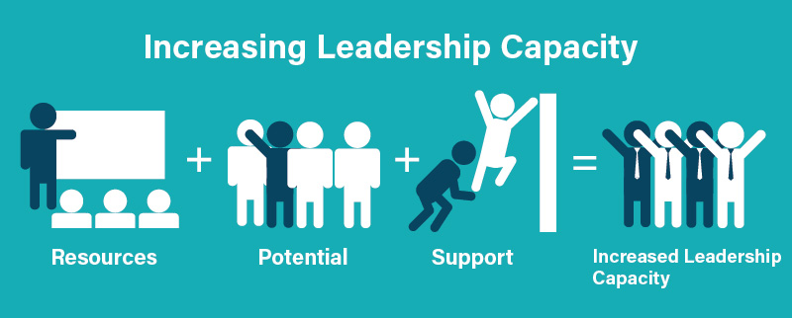
Conclusion
Notes:
Individuals often fall into leadership positions with no formal education to teach others about using it as a professional level resource throughout their careers (Hartzell, Yu, Cohee, Nelson, & Wilson, 2017). A survey on best practices reports on current leadership curriculum to validate topics regarding conflict resolution, implementing change, and ways to motivate other people. Respondents thought highly on effective strategies to establish small group exercises and leadership case studies. Cognitive interviewing by experts report components to value coaching and mentorship to improve the contents and delivery of leadership training skills. All professionals must lead within a system while collaborating with others to develop a step-wise approach toward understanding the needs and risks involving leadership education and barriers specific to new curricular demands. Trainees augment your ability to establish interactive methods to impact leadership with new time management resource.

Slide 15
References
Aydogan, E. and Khalfan, K.M. (2018). Barriers faced in effective training transfer: a research on foreign students. Journal of Defense Science, 17(1), 1 – 46.
Gavarkovsa, A.G., Bluntb, W., and Petrellab, R.J. (2019). A protocol for designing online training to support the implementation of community-based interventions. Evaluation and Program Planning, 72, 77 – 87. doi: 10.1016/j.evalprogplan.2018.10.013
Hartzell, J.D., Yu, C.E., Cohee, B.M., Nelson, M.R., and Wilson, R.L. (2017). Moving beyond accidental leadership: a graduate medical education leadership curriculum needs assessment. Military Medicine, 182(7), 1815 – 1822. doi: 10.7205/MILMED-D-16-00365
Noe, R. (2017). In the 7th (ed), employee training and development. McGraw-Hill Education. http://mheducation.com/highered
Sisson, J.A. (2019). Maturing the lean capability of front-line operations supervisors. International Journal of Lean Six Sigma, 10(1), 2 – 22.
Qari, S.H., Leinhos, M.R., Thomas, T.N., and Carbone, E.G. (2018). Overview of the translation, dissemination, and implementation of public health preparedness and response research and training initiative. American Journal of Public Health, 108(5), 355 - 362. doi: 10.2105/AJPH.2018.304709

